Slide 1

End to End Encryption

Slide 2
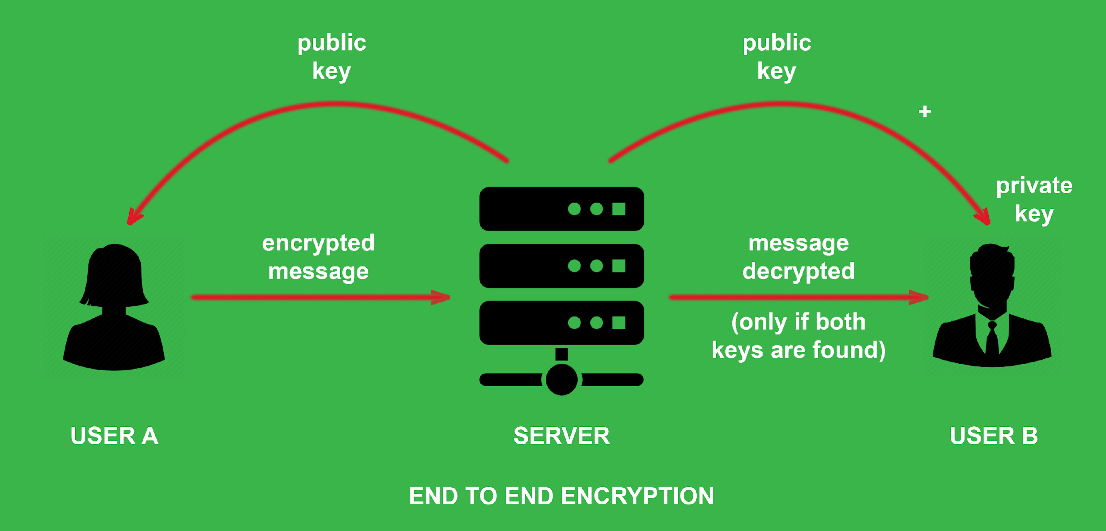
What is End-to-End Encryption
End-to-end encryption provides the gold-standard for protecting communication. In an end-to-end encrypted system, the only people who can access the data are the sender and the intended recipient(s) – and no one else.
Neither hackers nor unwanted third parties can access the encrypted data on the server

Slide 3
What is End-to-End Encryption
Encryption occurs at the device level.
Messages and files are encrypted before they leave the phone or computer and isn’t decrypted until it reaches its destination.
As a result, hackers cannot access data on the server because they do not have the private keys to decrypt the data.
Instead, secret keys are stored with the individual user on their device which makes it much harder to access an individual’s data.

Slide 4
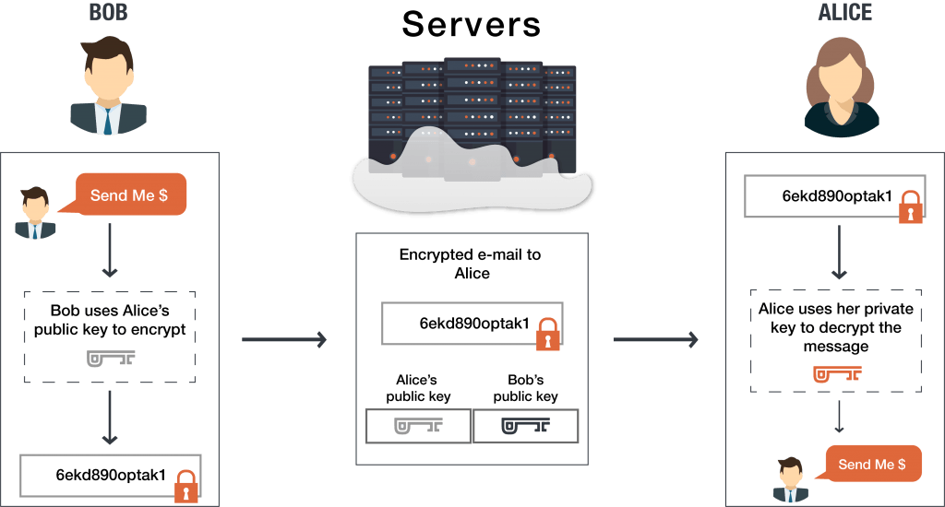
End-to-End Encryption - Example
Alice and Bob create accounts on the system.
The end-to-end encrypted system provides each with a public-private key pair, whereby their public keys are stored on the server and their private keys are stored on their device.

Slide 5
End-to-End Encryption - Example
Alice wants to send Bob an encrypted message. She uses Bob’s public key to encrypt her message to him.
Then, when Bob receives the message, he uses his private key on his device to decrypt the message from Alice.

Slide 6
End-to-End Encryption - Example

Slide 7
End-to-End Encryption - Example
When Bob wants to reply, he simply repeats the process, encrypting his message to Alice using Alice’s public key.

Slide 8
Can end-to-end encryption be hacked?
Security practitioners often point out that security is a chain that is only as strong as the weakest link.
Bad guys will attack the weakest parts of your system because they are the parts most likely to be easily broken.
Given that data is most vulnerable when stored on a server, hackers’ techniques are focused on gaining access to servers.

Slide 9
The advantages of end-to-end encryption
Ensures your data is secure from hacks:
With end to end encryption, you are the only one who has the private key to unlock your data. Data on the server can’t be read by hackers because they do not have the private keys to decrypt the information.
Protects your privacy:
Providers like Google and Microsoft can read your data. When you use their service, data is decrypted on their servers. If data is decrypted on their servers, then hackers and unwanted third parties can read it, too.
Protects admins:
Since admins don’t hold the decryption keys to decrypt the data, any attack that targets administrators will come up short.

Slide 10
Thank You

